Slide 1
Self-Reconfiguring Modular Robots (SRMRs)
By: Agustus Wilkinson and Samuel Daniels

Slide 2
Overview
3. Definition
4. History
5. Impact & Implementation
6. Pros
7. Cons
8. Pictures
9. Summary
10. References

Slide 3
Definition
A Self-Reconfiguring Modular Robot or a SRMR for short is a robot that can change shape by rearranging its parts to adapt to different circumstances, perform new tasks, or repair itself.

Slide 4
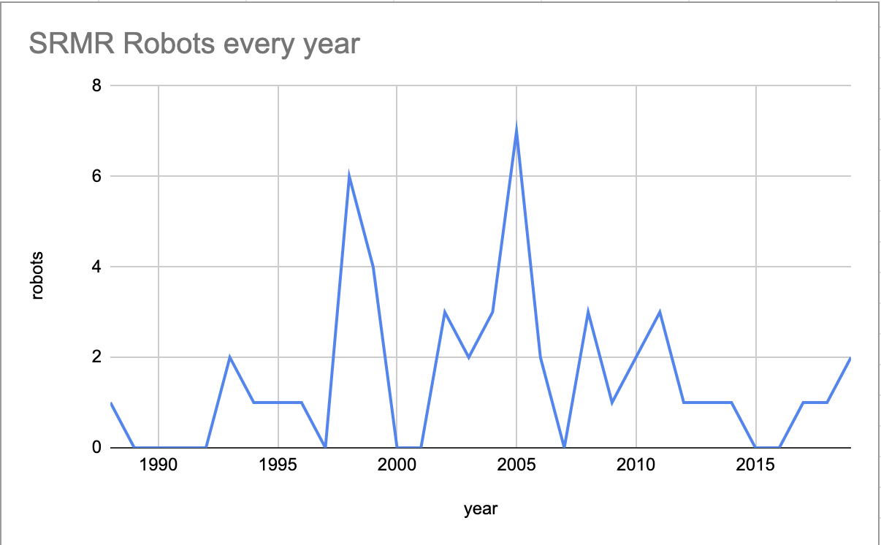
History
Notes:
SRMR robots have been in development since the last century. As you can see, we’ve been making progress with them since the 80s.

Slide 5
Impact & Implementation
A SRMR can turn into a snake like shape to fit into narrow holes and then turn into a different shape to repair.
Notes:
We can use these robots to make our daily lives easier by doing simple tasks for us. It will make life easier for those who aren’t physically able to perform things like moving furniture and opening and closing things.

Slide 6
Pros
Can lower robot cost by making a range of machines out of mass-produced modules.
They can help disabled people with tasks that they aren’t able to do
They help us with things we do daily
Notes:
The pros far outweigh the cons with SRMRs. These are some of the advantages to these robots.

Slide 7
Cons
They can malfunction and break things around them
They require more modules to perform certain tasks
They need different kinds of modules, so they would be very costly
Notes:
However, there are a couple problems with these machines.

Slide 8
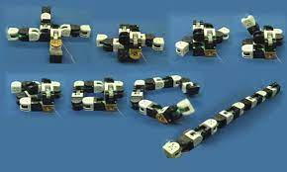
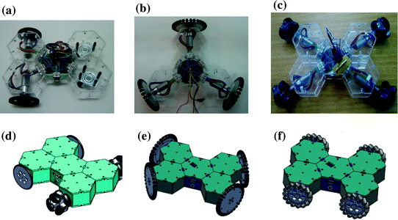
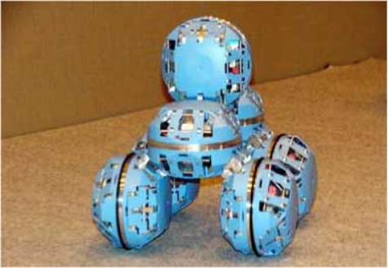
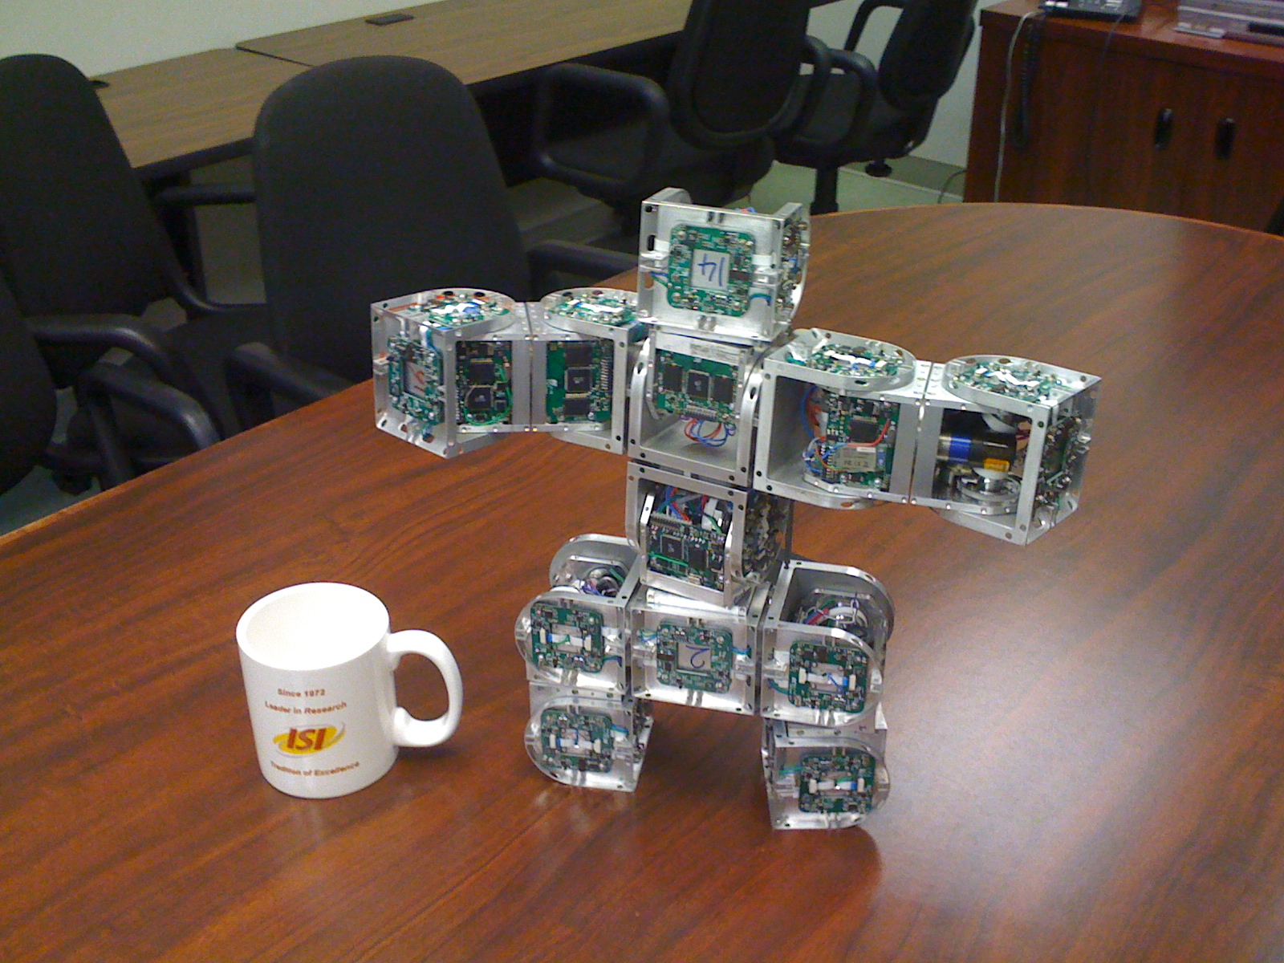
video

Slide 9
Summary
SRMRs will be a very useful tool in the future. They will help humans with many tasks. I think that we should continue developing them and making them better.

Slide 10
References
Modular Self-Reconfigurable Robotic Systems: A Survey on Hardware Architectures
These modular robots self-assemble to make and move furniture
Reconfigurable Robot

